Slide 1


Azure Database for MySQL and Maria DB
Speaker name or subtitle text

Slide 2
Technology changes faster than ever
IoT devices
Cloud computing
Search engines
Cell phones
Internet
Operating systems
Word processor
Microprocessor
Moon landing
Radio
Car
Telephone
Light bulb
Telegraph
Steam engine
Telescope
Printing press
1400
1500
1600
1700
1800
1900
2000
Notes:
The pace of technology advances is accelerating at an unprecedented rate. Breakthrough innovations are causing the volume of data to explode (data from sensors, social media, apps and data found across the enterprise within documents, excel files, for example).
The scale and economics of cloud computing make it possible to capture and harness data, creating new and exceptional opportunities for people and organizations to innovate, grow faster, and achieve more than ever before.
Organizations have the chance to fundamentally redefine the way they engage customers, transform products, optimize operations and engage employees.

Slide 3
Economic stability impacted by disruptive events
COVID-19 pandemic
Black Thursday
Black Monday
Brexit decision
US-China economic conflict
European debt crisis
Greek debt crisis
Great Recession
SARS outbreak
Dot-com bubble
Sept 11 attacks (US)
Early 1990s recession
Savings & loan crisis (US)
Black Monday
Early 1980s recession
Energy crisis
US economic recession
The Great Depression
World War II
World War I
1900s
1920s
1940s
1960s
1980s
2000s
2020s
Notes:
But, as economies become more interdependent, large-scale events can introduce volatility and uncertainty to global markets. Over time, the frequency of these events has accelerated.
How businesses respond in times of uncertainty is as varied as the businesses themselves. Many will slow down operations to operate more cost-effectively, while others may lean into new opportunities that may not have otherwise existed. Across this entire spectrum, the ability to cost-effectively adapt and scale to rapidly changing conditions and manage the underlying risk is paramount.

Slide 4
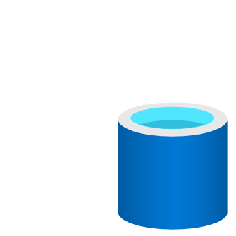
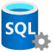








Bring your ideas to life with Azure
Limitless cloud database services
Unmatched analytics and insights
Unified data governance

Slide 5
State of relational and open-source databases
Open source is the future
> 40%
> 60%
90%
85%
70%
63%
Through 2020, relational technology will continue to be used for at least 85% of new applications and projects¹
By 2022, more than 70% of new in-house apps will be developed on an OSDBMS or OSDBMS-based dbPaaS²
DBaaS (Relational) is the top public cloud service used³
1. Gartner: “State of the Open-Source DBMS Market, 2018”
2. Gartner: “State of the Open-Source DBMS Market, 2019”
3. Source: “RightScale 2020 State of the Cloud Report from Flexara”

Slide 6



Azure managed databases include popular open source engines
Azure SQL Database
Azure SQL Managed Instance
Azure Database for PostgreSQL
Azure Database for MySQL
Azure Database for MariaDB
Azure Cache for Redis
Azure Cosmos DB
Managed, intelligent SQL in the cloud
Enterprise-ready, fully managed and scalable open-source databases
In-memory data store to power fast, scalable applications
Globally distributed, multi-model dataset service for any scale
Notes:
We have a rich portfolio of operational databases on Azure that are grounded in choice and flexibility. We want customers to have the right tool for every use case they encounter.
<Detailed descriptions of each database service for reference>
Azure SQL Database
Azure SQL Database is the intelligent, scalable, relational database service that supports modern cloud applications. It’s evergreen and always up to date, with AI-powered and automated features that optimize performance and durability for you. Serverless compute and Hyperscale storage options automatically scale resources on demand, so you can focus on building new applications without worrying about storage size or resource management.
Azure SQL Managed Instance
Azure SQL Managed Instance is the intelligent, scalable, cloud database service that combines the broadest SQL Server engine compatibility with all the benefits of a fully managed and evergreen platform as a service. Modernize your existing SQL Server applications at scale with SQL Managed Instance.
Azure Database for PostgreSQL is a relational database service based on the open-source Postgres database engine. It's a fully managed database as a service offering that can handle mission-critical workloads with predictable performance, security, high availability, and dynamic scalability
Azure Database for MySQL is a relational database service based on the open-source MySQL Server engine. It's a fully managed database as a service offering that can handle mission-critical workloads with predictable performance and dynamic scalability.
Azure Database for MariaDB is a relational database service in the Microsoft cloud. Azure Database for MariaDB is based on the MariaDB community edition (available under the GPLv2 license) database engine, version 10.2 and 10.3.
Azure Cosmos DB
Azure Cosmos DB is a globally distributed database service. It supports schema-less data that lets you build highly responsive and Always On applications to support constantly changing data. You can use this feature to store data that is updated and maintained by users around the world. The following illustration shows a sample Azure Cosmos DB database that's used to store data that's accessed by people located across the globe.

Slide 7
Be future-ready with Azure and open source
Leverage your favorite open source services on Azure with:
Seamless migration of Linux workloads
Support for modern devops practices using Azure Kubernetes Service and Git operations
Choice of fully managed open source database including MySQL, PostgreSQL and MariaDB
Compatibility with latest open source extensions and tools
Develop Java, Python, and php based applications with platforms like Magento, Shopify, Moodle, Alfresco, Drupal and WordPress
Enjoy community-driven quality with a large developer network
Configuration
Easy set up
Scale
Limitless
Management
Less maintenance
Azure
OSS
Security
Always a step ahead
90% of enterprises deploy open source in some form
Notes:
Microsoft Azure is the cloud that lets you turn ideas into solutions with more than 100 services to build, deploy, and manage applications—in the cloud, on-premises, and at the edge—using the tools and frameworks of your choice. Our track record of continuous innovation supports your development today and your visions for tomorrow. Over the past year, we’ve launched over 1000 capabilities on the platform, helping our customers be future-ready. The cloud is moving fast – every week a new technology is coming out. So it’s about meeting new capabilities now and investing in those on the horizon.
In the world of data, we are committed to empowering organizations to build on their terms with flexibility and choice, and that includes the freedom to operate anywhere.
Nothing is more important than trust, particularly when you’re talking about the cloud. We spend $1B a year on cyber security with 3500 cyber security engineers who are constantly monitoring your data for threats. We’ve invested ahead of the curve in layers of security with built-in controls to protect your data and close the gaps that attackers can exploit. Trust your workloads to Azure, built upon the most secure cloud with the broadest compliance coverage.
Break through the resource constraints of modern application development with limitless scale that goes far beyond other cloud providers.
Modernize existing apps or build new apps on Azure with built-in, AI-based technologies that power new customer experiences.
Azure can help you innovate today, tomorrow, and in the future. We are constantly providing capabilities that can help meet your needs.

Slide 8

Open source developers are using MySQL and MariaDB databases
54% of devs build on MySQL, the most popular OS database
3x popularity growth of MariaDB in the last three years
Key reasons behind the popularity
OLTP
Community support and a rich ecosystem of tools
Lower TCO from fewer licensing fees
Low resource consumption through ongoing advancements
Optimized for OLTP websites
A key part of the LAMP stack
Notes:
https://insights.stackoverflow.com/survey/2019?utm_source=so-owned&utm_medium=blog&utm_campaign=dev-survey-2019&utm_content=launch-blog
http://www.oracle.com/us/products/mysql/mysql-wp-top10-webbased-apps-461054.pdf
https://db-engines.com/en/blog_post/77

Slide 9
Focus on your application, not your database
PaaS
Azure Database for MySQL and MariaDB
IaaS
Azure VMs with MySQL and MariaDB
On-premises
MySQL
Intelligent performance/security
Enterprise-grade managed services for MySQL and MariaDB that consistently delivers value and performance
Applications
Applications
Applications
Data
Data
Data
High availability /DR/Backups
High availability /DR/Backups
High availability/ DR/Backups
Database provision/ Patch/Scaling
Database provision/ Patch/Scaling
Database provision/ Patch/Scaling
O/S provision /patching
O/S
O/S
Virtualization
Virtualization
Virtualization
Hardware
Hardware
Hardware
Datacenter management
Datacenter management
Datacenter management
Machine learning capability
Managed by customer
Managed by Microsoft

Slide 10
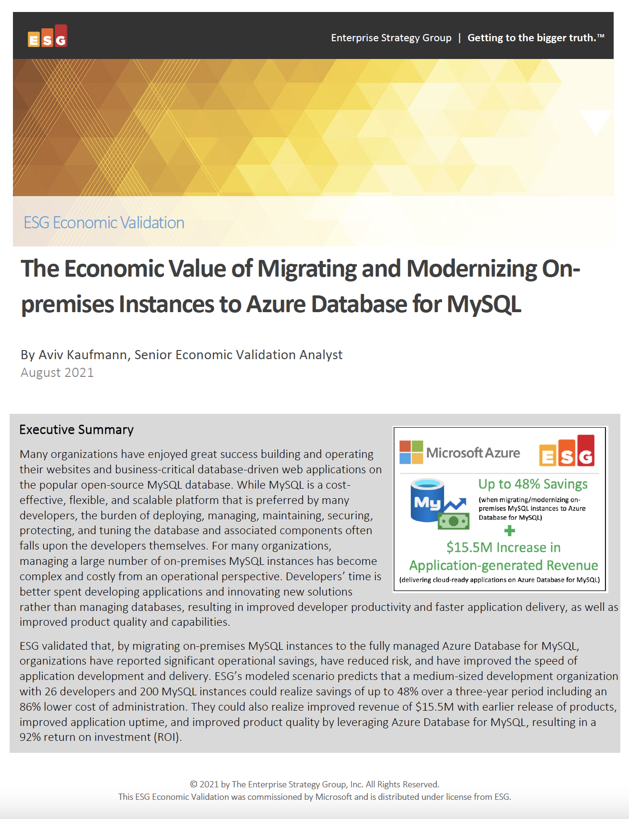
Significantly reduce cost when migrating workloads to PaaS
Key report benefits and findings¹
Up to 48%
Cost savings when migrating on-premises MySQL instances to Azure Database for MySQL
Microsoft commissioned Enterprise Strategy Group to conduct an Economic Value study to examine potential cost savings and business benefits enterprises would achieve from migrating on-premises workloads to Azure Database for MySQL.
Modernizing on Azure Database for MySQL yields even greater benefits…
+$15.5M
Additional revenue due
to faster time to market
93%
Reduction in
operational cost
92%
ROI expected over
the first year
86%
Lower cost of systems administration
1 Results are based on interviewed customers. “The Economic Value of Migrating and Modernizing On-premises Instances to Azure Database for MySQL,” a commissioned study conducted by The Enterprise Strategy Group on behalf of Microsoft, September 2021.
Notes:
We partnered with the Enterprise Strategy Group to validate the cost savings, operational efficiency, and improved business agility that customers reported when migrating their on-premises MySQL instances to Azure Database for MySQL Flexible Server and the TOP-LEVEL FINDINGS from ESG’s model FOUND THAT Azure Database for MySQL provided UP TO a 48% LOWER TOTAL COST over a three-year period to deliver the services to host, secure, and protect MySQL instances.
This included an enormous 93% reduction in the operational cost to deploy, manage, and maintain MySQL instances on an on-premises environment. Azure Database for MySQL offloads the majority of the work currently performed by developers, which reduces the EXPECTED cost to administer, tune, secure, protect, and maintain the MySQL databases by UP TO 86%.
These savings equate to roughly 4 full-time developers’ worth of PRODUCTIVITY SAVED, which equates to a 20% increase in development capacity, resulting in $15.5M dollars in additional expected revenue for the organization.
This is a perfect example of how Azure managed open source databases can reduce your total cost of ownership when migrating your workloads to Azure.

Slide 11





Azure Databases for MySQL Brings Azure innovation to your favorite community database
Cost effective, fully managed MySQL database
Easy to provision and scale
Build resilient and responsive mission critical applications
Develop and deploy applications faster with the power of Azure
Build on a trusted platform
Fully managed MySQL database with a 48% lower total cost¹ of ownership than on-premises deployments
Provision a database in less than 2 minutes. Easily scale your database with AI powered database monitoring
Optimize your application with query insights and performance tuning recommendations for your mission critical workloads.
Tap into the power of Azure by integrating with Azure Cognitive Services, Azure Kubernetes Service, or Azure App Service.
Deliver data-powered experiences with the security and privacy controls required to innovate with confidence.
Notes:
Azure Database for MySQL is a cost effective, fully managed MySQL database service in Azure which is easy to provision and scale. Customers and developers can focus on application development instead of managing the infrastructure, operating system, MySQL software, and so on.
Azure Database for MySQL works with PHP, Java, Python, Node.JS, Ruby, .NET, and applications can be hosted in Azure App Service, Azure Kubernetes Service, and Spring Cloud. There is also a great integration to other Azure services, including the end-to-end data platform and the AI services such as Cognitive Services which all can be used when building innovative, intelligent solutions.
Customers and developers will be able to build and deploy their data centric applications with the security and privacy controls required to innovate with confidence
¹ - aka.ms/mysqlflexibletco

Slide 12
Azure Database for MySQL deployment options
Flexible Server
Single Server
Maximum control for your databases with more cost optimization controls
Example use cases
Application developments requiring more control and customizations
Mission-critical apps needing high availability and fine-grained maintenance scheduling
Applications requiring variable compute capacity to optimize costs
Fully-managed, MySQL database service with built-in HA
Example use cases
Cloud native applications designed to handle automated patching
Online web applications with minimal requirements for database customizations
Applications without zonal redundancy requirements

Slide 13

Maximum control and flexibility to meet your workload needs with Flexible Server
Maximum control for your databases
Build resilient apps across availability zones
Simplified developer experience
Control planned downtime with custom maintenance windows
Network isolation with VNet integration and network security groups
Multiple configuration parameters for fine grained database optimization and tuning
Ensure data is always available with zone redundant high availability
Zero data loss within single and multiple availability zones
Guided developer experience increases productivity and simplifies end-to-end deployment
Full compatibility with community edition MySQL
Stop/Start and burstable capabilities for cost optimization

Slide 14

Fully managed community database with a lower TCO

Slide 15
Use your community database as a fully managed service
MySQL community versions 5.7 and 8.0
MariaDB community version 10.2 and 10.3
Infrastructure and database management, including feature updates, handled by Azure
Options for popular Java, Python and php based applications through Azure Kubernetes Service or Azure App Service
Guaranteed SLA of 99.99% connectivity

Slide 16
Optimize costs and lower total cost of ownership
Flexible pricing options
Reserved Capacity
Stop/Start functionality
Burstable compute SKUs
Scale compute, memory, and storage independently and pay only for what you use. Includes automatic database patching, query optimization, and security all at no extra cost
Choice of 1-year or 3-year Reserved Capacity pricing and save up to 60 percent compared to the regular pay-as-you-go payment options
Stop the MySQL server when it's not needed for up to 7 days. When the database is stopped, only pay for storage*
Utilize Burstable CPU credits for workloads that need extra performance during peak times*
No upfront cost. No termination fees. Pay only for what you use.
Notes:
* Only available with Flexible Server

Slide 17

Maximum control, scalability, and built-in security

Slide 18
Maximum control & scalability
Predictable patching and maintenance
Robust database tuning options
Dynamic scaling for changing workloads
Massive scale out capacity
Make patching cycles predictable by controlling custom maintenance windows and scheduling, all with minimum impact to your business
Choose from a wide set of MySQL server parameters for fine-grained tuning of database performance
Increase or decrease IOPS provisioned based on your workload requirements. Dynamic scalability enables your database to transparently respond to rapidly changing resource requirements
Scale out up to 640 vCores with up to 10 read replicas

Slide 19


Advanced data security and compliance
Best-in-industry protection from intellectual property risks with the Azure IP advantage
Azure Defender
Virtual
networks
Data
encryption
Built-in compliance
Detect potential threats and respond to them as they occur with Azure Defender for Open Source*
Control data isolation by configuring a virtual network
Data is automatically encrypted at rest and in motion. Perform double encryption with custom keys and Transport Security Layer (TLS) 1.2 enforcement
Get industry-leading compliance, such as HIPAA, PCI DSS, FedRAMP, and ISO, built-in**
Notes:
*Only available with Flexible Server
**Compliance certifications only available with Single Server. Certifications still underway for Flexible Server.

Slide 20

Build resilient, high-performance apps across availability zones

Slide 21
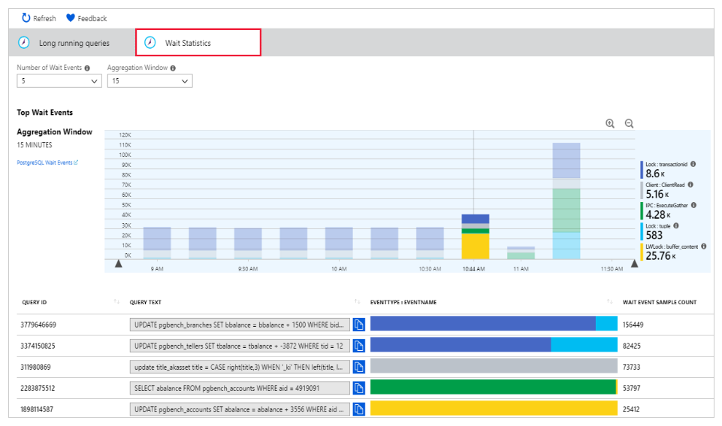
Enhance performance with Query Store and Query Performance Insight
Uncover long query times with Query Store
Query Store simplifies performance troubleshooting by quickly finding the longest running and most resource-intensive queries
Query Performance Insight quickly identifies the longest running queries, how they change over time and what waits are affecting them
Query times
Time
Wait statistics in Query Performance Insight
Notes:
Query Store simplifies performance troubleshooting by helping you quickly find the longest running and most resource-intensive queries

Slide 22
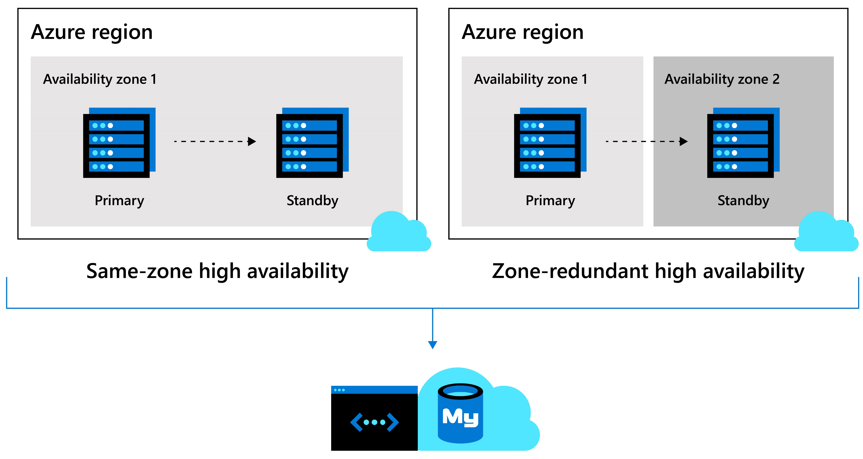
Built-in high availability
Build resilient, high-performance apps across availability zones
Ensure data is always available with either same-zone or zone-redundant high availability backed by industry-leading SLA’s
Automatic failover also ensures zero data loss within multiple availability zones
Fast automatic failover in 60-120 seconds

Slide 23

Innovate and build apps faster with the Azure ecosystem

Slide 24







Innovate with the Azure ecosystem
Easily spin up a database for popular Java, Python and php based applications through Azure Kubernetes Service or Azure App Service
Leverage GitHub actions to deploy updates to your database by enabling simpler and faster innovation with integrated Azure technologies
Develop applications with platforms like Magento, Shopify, Moodle, Alfresco, Drupal and WordPress

Slide 25
Build apps faster on Azure Database for MySQL
Deploy the power of Azure by integrating with Azure Cognitive Services, Azure Kubernetes Service, or Azure App Service
Accelerate time to market with LAMP stack
Best-in-industry protection from intellectual property risks with the Azure IP advantage
28% AKS attach rate to Azure Database for MySQL

Slide 26





Optimize cost and ensure business continuity with Azure Databases for MySQL and MariaDB
Reduce service downtime and failure prevention with Azure Database for MySQL Flexible Server
Connect with customers online with a modern web experiences
Ensure sales continuity with reliable ecommerce platform
Provide a high-quality remote learning with learning management solutions (LMS)
Get to market quickly building modern apps on Azure Database for MySQL
Increase the reliability of your database with options like scheduled maintenance updates with Azure Database for MySQL Flexible Server
Easily build open source web apps using popular CMS (WordPress or Drupal) and enterprise packaged applications like Alfresco.
Develop ecommerce applications including popular packaged applications such as Magento or Shopify
Deliver online educational programs with Moodle and Azure Database for MySQL
Build new custom apps in the cloud with microservice architecture using Azure Kubernetes and Azure Database for MySQL or MariaDB
Notes:
Intelligent apps
Develop sophisticated, transformational apps using state-of-the-art machine-learning algorithms and integrated visualization tools for analytics and actionable insights.
Retail and e-commerce
Build highly secure and scalable e-commerce solutions that meet the demands of both consumer and business customers. Engage customers through targeted products and offers, process transactions quickly, and optimize fulfillment and customer service.
Scalable web and mobile applications
Rapidly build engaging, scalable cross-platform and native apps for iOS, Android, Windows, or Mac.
Digital marketing
Engage with customers around the world with rich, personalized digital marketing experiences. Quickly build and launch digital campaigns that automatically scale based on traffic and customer demand.
Financial management apps
Securely store critical data and provide high-value analytics and insights over aggregated data to users, using built-in security and high availability.
Gaming
Scale your databases elastically to accommodate unpredictable bursts of traffic and deliver low-latency multi-player experiences.

Slide 27

When to use Single Server vs. Flexible Server
When to use Single Server vs. Flexible Server
 | Flexible Server | Single Server
Database Version | MySQL 5.7, 8.0 | MySQL 5.7, 8.0
High Availability | Zone Redundant HA, Same zone HA (MySQL) | Built-in HA (Single-AZ)
Scheduled Maintenance | System or custom scheduled | System scheduled
Stop/Start |  | X
PITR
Network Isolation
Customer managed keys for Encryption
Reserved Instances (RI)
Cross region replicas
Uptime SLA | 99.99%* | 99.99%
*zone-redundant HA 99.99%
Notes:
Zone redundant – 99.99%
Same-zone – 99.95%

Slide 28

















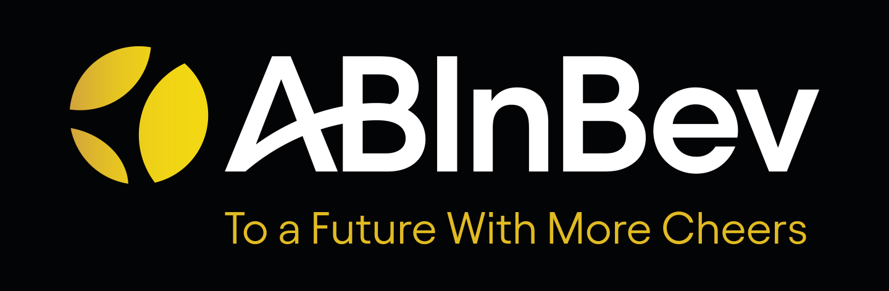
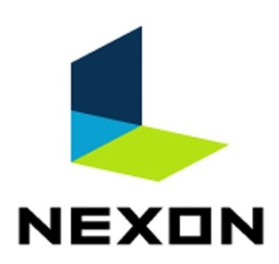

Azure Database for MySQL use cases by industry
Gaming
LMS
IT/Telecom
Healthcare
Banking
Web & CMS
E-commerce
Mobile or desktop gaming apps
Moodle app
E-learning app
Billing / payment app
Health benefit app
Claims processing
Mobile banking app
Digital transaction apps
ECM or CRM apps
WordPress
Retail
Transactional apps
Magento app

Slide 29
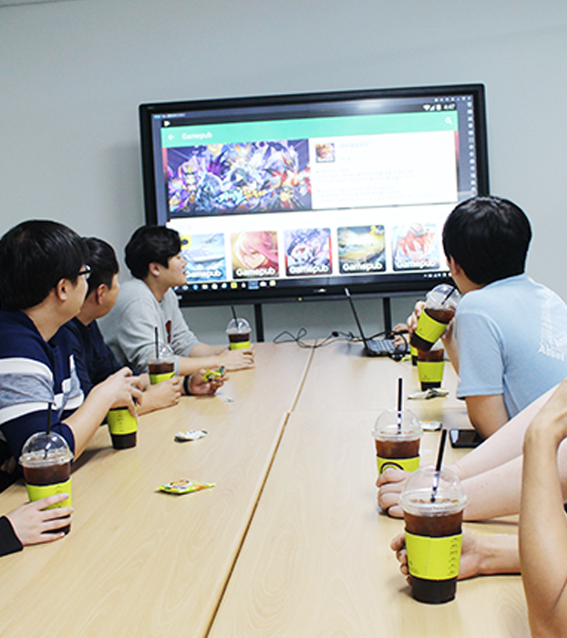
Gamepub keeps gamers happy by reducing downtime
HQ in Seoul, South Korea, Gamepub is a major mobile game publisher that needed a fast and reliable database
Gamepub has been able to reduce service downtime, failure prevention and analysis has become much easier.
With Flexible Server’s scheduled maintenance updates Gamepub controls maintenance to coincide with game updates.
Gamepub has seen 25% reduction in time and human resources by deploying Flexible Server.
“Server provisioning, maintenance, and monitoring requires a lot of time and human resources. Compared with installing and using MySQL on a virtual machine, I saved about 25 percent of resources by deploying the Flexible Server option.“
Seokchan Sohn
System Team Lead
Notes:
Gamepub is a recent customer that deployed their new mobile game, Island, on Flexible Server.
Since they’ve deployed Azure Database for MySQL on Flexible Server, they’ve been able to see reduced service downtime with custom maintenance windows AND failure prevention and analysis has become much easier for them. Seokchan Sohn, the Lead of Systems at Gamepub, reported a 25% savings in both time and human resources because server provisioning, maintenance, and database monitoring has become much easier for them.
When there’s downtime that’s not related to content updates, it impacts customer loyalty and retention, because gamers are disappointed even when theres a short delay in access. The ability to control maintenance windows with Flexible Server is extremely important to Gamepub to minimize downtime and keep gamers happy.
Now Gamepub can control the timing and scheduling of maintenance to coincide with the release of game updates. Management tasks, such as disk volume size changes and IOPS performance optimization can be run online without maintenance. Therefore they have been able to eliminate 2 unnecessary maintenance periods per quarter by using Flexible Server.
This is just one of the many examples of how customers that deploy Azure Database for MySQL are saving time, cost, and human resources. Aviv Kaufman from the Enterprise Strategy Group will take us through his analysis to further validate the benefits and cost savings associated with Azure Database for MySQL.

Slide 30


Linked Brain gains stability, management with Azure
Video game developer Linked Brain Inc. chose Azure Database for MySQL Flexible Server as the platform for development and production for a mobile online game release.
Flexible Server enabled scaling up and down without stoppages, offer backup capabilities, and deliver I/O capacity proportionate to storage size.
Even though most mobile games experience unexpected access rates immediately after launch, Linked Brain had zero issues after release.
“We learned Flexible Server could scale up and down without stoppages, offer backup capabilities, and deliver I/O capacity proportionate to storage size, which makes it easy to boost performance as data accumulates.“
Kensuke Suzuki Chief Data Officer
Notes:
Linked Brain Inc., is a game developer company headquartered in Japan that wanted to shift from IaaS to PaaS and chose Microsoft Azure as the platform for development and production. In
In November 2019, a Microsoft gaming industry sales rep visited Linked Brain to explain Microsoft Azure services and FastTrack for Azure. They were particularly interested in Azure’a easy-to-scale web server, which requires almost no maintenance. Linked Brain didn’t have the resources to secure dedicated infrastructure engineers at our scale and they could keep just 1 in-house engineer on staff to manage the platform.
They were attracted to Azure Database for MySQL Flexible Server’s abilities to scale up and down without stoppages, offer backup capabilities, and deliver I/O capacity proportionate to storage size, which makes it easy to boost performance as data accumulates.
They received a ton of pre- migration, migration, and post-migration help from the FastTrack for Azure team as well, which was a huge benefit to them during the migration process.

Slide 31
Resources
Gear Up
Azure Database for MySQL Migration BoM
Case Studies
Gain Economic Value when migrating to Azure Database for MySQL
Flexible Server Infographic
Try Azure Database for MySQL for free

